Slide 1
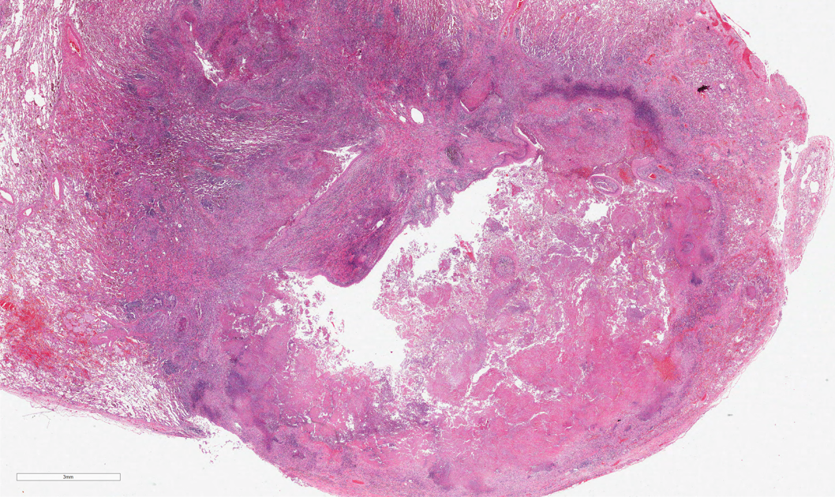
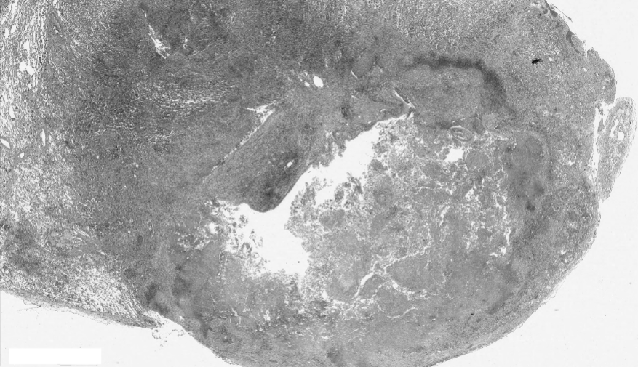
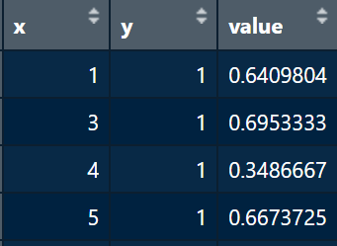
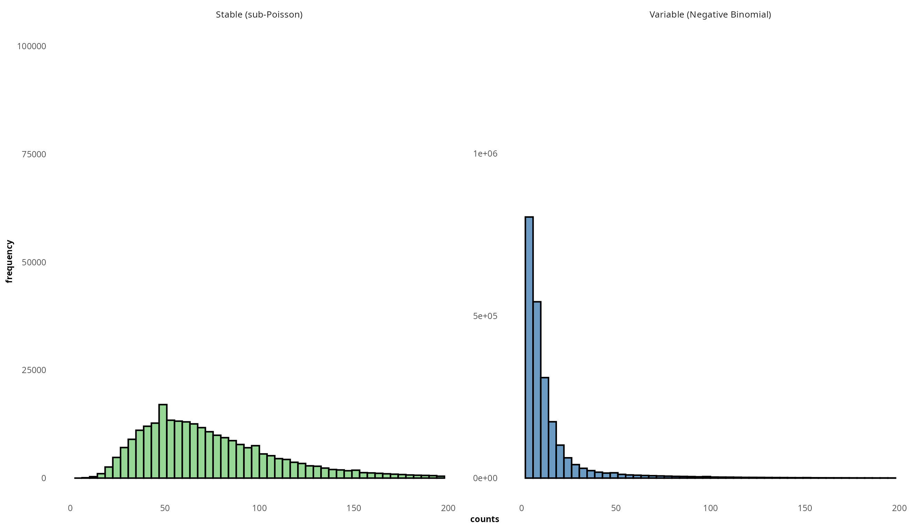
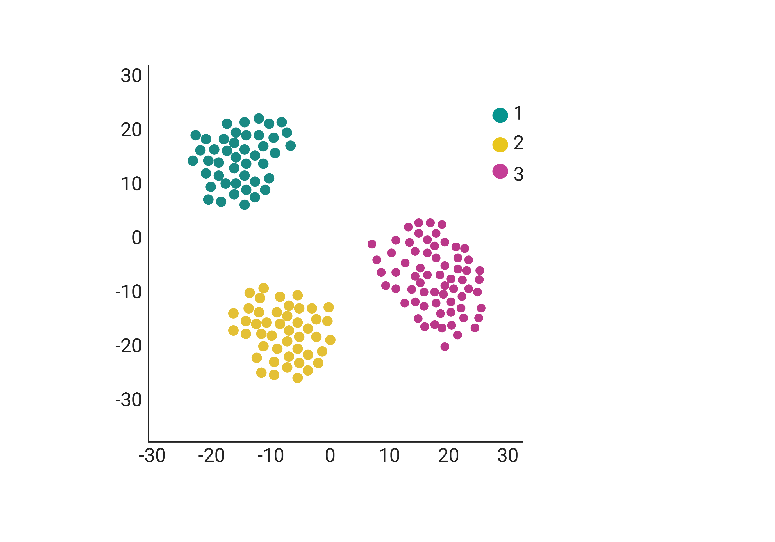
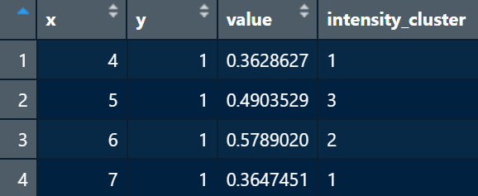
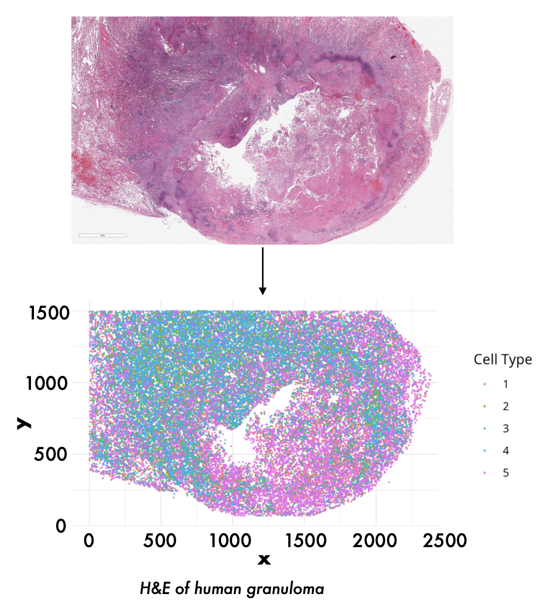








Simulation framework for spatial single-cell RNA-sequencing data
Daniele Sabbatini^{1,2}, Pierangela Palmerini^{1,3}, Giorgia Stoppa¹, Dolores Cattelan¹, Annibale Biggeri¹, Dario Gregori¹ and Luca Vedovelli¹
¹Department of Cardiac, Thoracic, Vascular Sciences and Public Health, University of Padua, Italy
²Department of Neurosciences, University of Padua, Italy
³Veneto Institute of Oncology-IRCCS, Padua, Italy
Introduction
Developing robust analytical methods for single-cell spatial transcriptomics requires rigorous evaluations against data with a known ground truth, yet generating such gold-standard data experimentally is prohibitively expensive, time-consuming, and technically challenging. Computational simulations provide a compelling alternative by producing synthetic datasets with fully controllable properties. However, many existing simulators rely on oversimplified statistical assumptions, unrealistic tissue geometries, homogeneous technical artifacts, and artificially sharp boundaries. Our framework overcomes these shortcomings with advanced statistical models and biologically informed spatial patterns, recreating realistic noise, gradual transitions between cell types, and enabling systematic benchmarking under near–in vivo conditions.
Methods
1. Configurating parameters
2. Image processing and thresholding
Number of marker genes per cell type: Determines how many genes are designated as distinguishing features for each cell type.
Marker gene fold-change: Sets the expression intensity of marker genes, influencing how distinct each cell type appears.
Overlap among cell types: Indicates the extent to which marker genes are shared across multiple cell populations, increasing the difficulty of differentiating them.
Spatial noise: Introduces position-dependent variations in expression, simulating the natural spatial heterogeneity found in tissues.
Spatial correlation range: Defines the distance over which expression levels remain correlated, modeling continuous gradients across the tissue.
Random noise (SD): Adds baseline stochastic fluctuations, reflecting biological and technical variability.
Dropout range: Controls the probability that transcripts are “lost” or not detected, which mimics technical limitations in gene capture.
Dispersion range: Determines the variance structure in the statistical model (e.g., Negative Binomial), capturing the overdispersion frequently observed in real data.
Cell-specific noise (SD): Introduces additional variability on a per-cell basis, creating more nuanced and realistic expression patterns.
Based on the listed parameters, we defined three difficulty levels (Easy, Medium, Hard). The idea is that, by gradually increasing the degree of overlap among different cell types, their transcriptomic signatures become more similar, making it increasingly difficult to distinguish between the cell types being analyzed. At the “Easy” level, cell types are well separated and have highly defined markers, whereas at the “Hard” level, the strong overlap of markers and the increased technical and biological variability make the cells much more similar to each other.
a) loading the input image (H&E staining)
b) converting color images to grayscale
c) “squeezing" the image to remove redundant dimensions
d) generating data frame with spatial coordinates (x, y) and intensity values
e) thresholding to exclude high-intensity background pixels
human granuloma
H&E
human granuloma
greyscale
Final gene expression
Stable genes (10%): sub-Poisson variance
Regular genes: spatially-varying Negative Binomial
3. Clustering and sampling
human granuloma
4. Generating expression matrix
Clustering: K-means++ algorithm is used to cluster pixels with similar intensity, mimicking distinct cell types in real biological data
Sampling:
a) calculate frequency of each cluster
b) determine how many cells to sample from each cluster
c) randomly sample cells from each cluster
d) generate collective data frame
Spatial Correlation Models
We employ a Gaussian Process with an exponential covariance to simulate spatially correlated expression within a chosen range, governed by parameters for correlation length (ρ) and variance (σ²). This mimics biological processes like molecular diffusion and gradual tissue gradients. Additionally, we introduce hybrid cells at boundary regions, blending expression from neighboring cell types to capture the intermediate phenotypes observed in real tissues.
1000000
750000
500000
250000
0
0
50
100
150
200
subsampled dataframe
50000
counts
25000
Results
0
50
200
0
100
150
1
Simulated data are capable of reconstructing input spatial pattern in different tissues
2
We evaluated clustering quality using the Rand Index (RI) and its adjusted version (ARI). The Rand Index measures the fraction of pairs on which the partitions agree giving values near 0 for random partitions and 1 for a perfect match. In addition, we report Adjusted Mutual Information (AMI), which quantifies how much knowing the cluster label in one partition reduces uncertainty about the other.
counts
Validation of the simulation
Two analysis framework were used to validate simulated data:
-Seurat v5 with SCT normalization -HDBSCAN
Advantages of the proposed framework
Method | ARI | AMI | Level
Seurat | 0.65 | 0.59 | easy
HDBSCAN | 0.66 | 0.59 | easy
Seurat | 0.46 | 0.51 | medium
HDBSCAN | 0.46 | 0.41 | medium
Seurat | 0.07 | 0.07 | hard
HDBSCAN | 0.0000117 | 0.0000137 | hard
Full control over simulation parameters:
→ known ground truth
Overdispersion of gene counts:
→ accurate modeling of variance exceeding the mean (overdispersion), a hallmark of real transcriptomic data;
→ representation of the heterogeneous biological noise across different tissue regions
Continuous spatial correlation sing Gaussian processes:
→ transitions between biological regions, capturing the natural continuity of tissues
In our experiments, as dataset complexity increases (easy → medium → hard), clustering accuracy (assessed by both Seurat and HDBSCAN) declines notably. Additionally, our current HDBSCAN pipeline does not yet surpass Seurat, although further improvements are in progress.
Conclusions
References & Contacts
The framework enables the generation of spatial transcriptomics data that reflect the statistical properties observed in real experiments
it supports the development of analytical methods and provides a foundation for benchmarking in spatial genomics studies
potential extensions include the introduction of further complexities such as multi-resolution variations
we evaluated a standard Seurat pipeline against a modified approach, and Seurat currently shows slightly better performance, although further optimizations are underway.
daniele.sabbatini@unipd.it
luca.vedovelli@ubep.unipd.it

